Slide 1

AI-Driven Predictive Maintenance System Using Time-Series Sensor Data
By: Thilak

Slide 2

Problem Statement
Consequences of Ignoring Predictive Maintenance
Why Existing Methods Fall Short
The Gap in Current Maintenance Systems
  Reactive or scheduled maintenance cannot predict failures in advance.
  Manual inspection and rule-based systems lack accuracy and scalability.
  Sensor data is complex and time-based, so AI is needed to interpret it.
  No unified AI framework for RUL estimation.
  Poor integration of models with alerts and visuals.
  Need for a reliable, automated maintenance prediction system.
  Unplanned shutdowns disrupt production and increase losses.
  Maintenance is either too early (wasteful) or too late (risk of failure).
  Lack of data-driven insights leads to inefficient resource allocation.

Slide 3
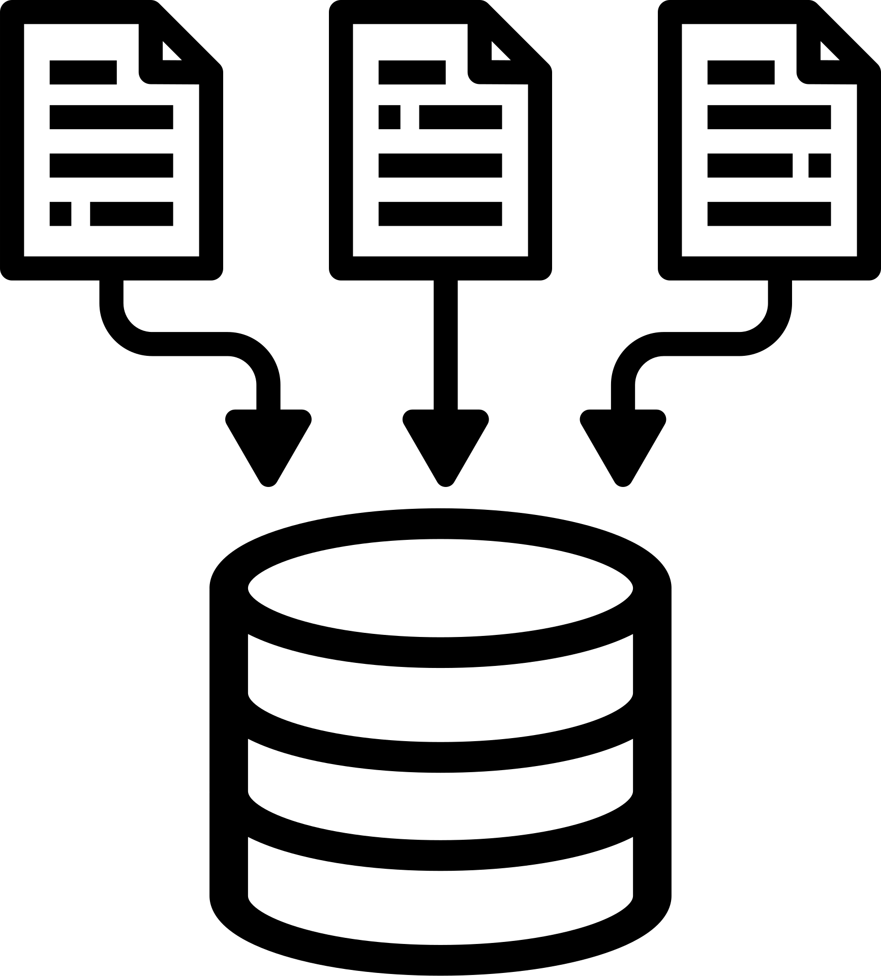


Project Objective
  Develop an AI-based predictive maintenance system capable of forecasting the Remaining Useful Life (RUL) of industrial components.
  Enable data-driven maintenance decisions to reduce downtime and optimize asset utilization.
  Leverage deep learning models (Bi-LSTM) to capture time-dependent degradation patterns from sensor data.
RUL
Prediction
Data
AI Model
Alerts

Slide 4
Milestone 1: Data Preparation & Feature Engineering
Objective: Prepare data for sequence learning and RUL prediction.
  Loaded and cleaned the CMAPSS dataset (train_FD001_processed.csv).
  Generated 50-cycle rolling window sequences for each engine unit.
  Computed and clipped RUL values at 100 cycles to handle outliers.
  Split the data into train, validation, and test sets using GroupShuffleSplit to ensure unit-level separation.
  Created structured feature matrices (X, y, and groups) ready for model training.

Slide 5
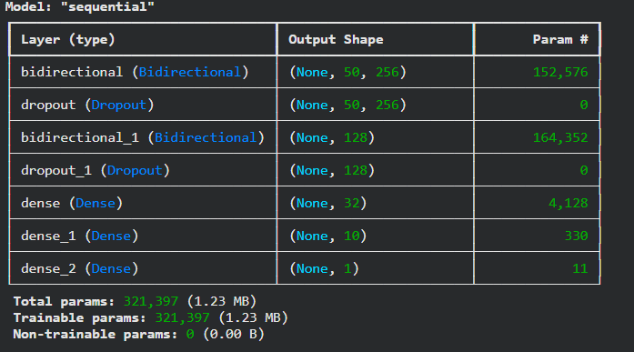
Milestone 2: Model Development
Bidirectional LSTM Architecture
Performance-Oriented Design
  Learns forward and backward temporal dependencies for accurate RUL prediction.
  Handles sequential degradation trends effectively using 50-cycle input sequences.
  Loss Function: Mean Squared Error (MSE)
  Metrics: Root Mean Squared Error (RMSE), Mean Absolute Error (MAE)
  Minimizes overfitting through dropout and bidirectional context learning.
Optimized Training Pipeline
Outcome
  Optimizer: Adam (learning rate = 0.0005)
  Epochs: 150 | Batch Size: 64
  Callbacks: EarlyStopping & ModelCheckpoint for stable convergence
  Successfully trained Bi-LSTM model with smooth loss convergence.
  Model effectively learns temporal degradation patterns.
  Achieved high accuracy and robust generalization on unseen test data.

Slide 6
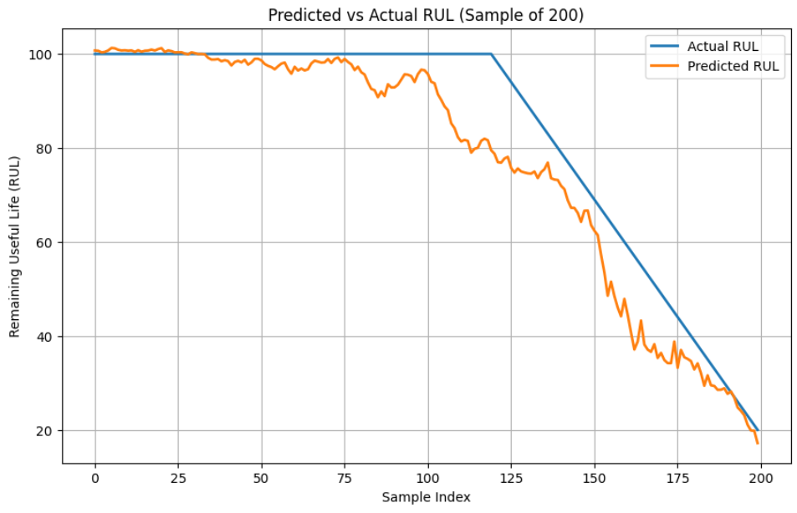
Milestone 3: Model Evaluation
RMSE
Measures the square root of the average squared differences between predicted and actual RUL values — penalizes large errors heavily.
R²
Indicates how well the model explains the variance in actual RUL values — closer to 1 means stronger predictive accuracy.
MAE
Represents the average of absolute differences between predicted and actual values — provides an easy-to-interpret measure of overall error.
Final Test RMSE: 7.9447
Final Test MAE: 5.3960
Final Test R² Score: 0.9438

Slide 7
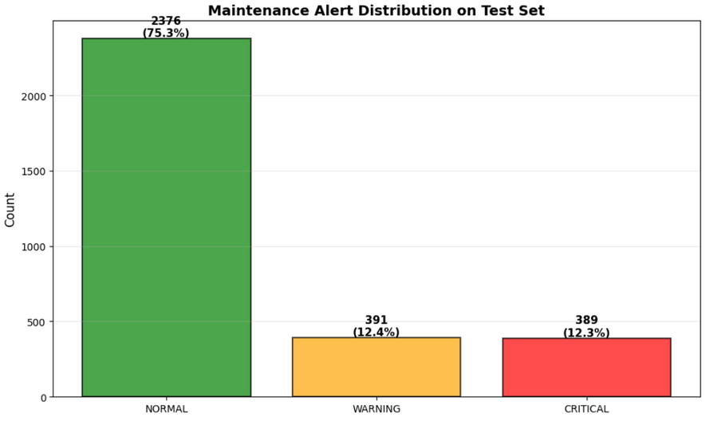
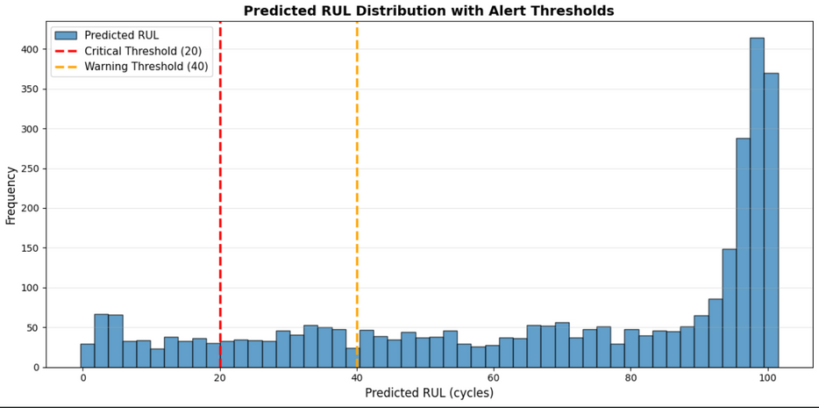
Milestone 4: Risk Thresholding &
Alerts
Objective: Translate RUL predictions into actionable maintenance alerts.
Warning Zone: RUL < 40 cycles ⚠
Critical Zone: RUL < 20 cycles 🚨
Predicted alerts help prioritize maintenance.

Slide 8




Milestone 5: Visualization & Dashboard
1️⃣ Overview
Interactive Dashboard
🧠 Model Integration:
2️⃣ Results
3️⃣Alerts
Built using Streamlit with gradient UI and sidebar navigation.
BiLSTM model predicts Remaining Useful Life (RUL) from time-series sensor data.
4️⃣Chatbot
📊 Quick Stats
Model Type
BiLSTM
Test R²
0.9438
Features
20
📊 Performance Metrics:
🤖 AI Chatbot:
Displayed using Plotly charts (RMSE, MAE, R², Mean Bias, Error Std).
Powered by Tavily API for user interaction and explanation of results.

Slide 9
Conclusion:
Deployed Dashboard:
https://milestone5-fewucmtz4wjy4nwvowtfpv.streamlit.app/
  PrognosAI demonstrates how AI-driven predictive maintenance enhances industrial reliability and efficiency.
  The Bi-LSTM model accurately predicts Remaining Useful Life (RUL) using time-series sensor data.
  The integrated Streamlit dashboard provides real-time visualization, alert generation, and AI assistant interaction.
  The system enables a shift from reactive to proactive maintenance, reducing downtime and optimizing asset utilization.

